Slide 1
Chapter 4:
Data Mining Process, Methods, and Algorithms
Slide in this Presentation Contain Hyperlinks. JAWS users should be able to get a list of links by using INSERT+F7
Notes:
If this PowerPoint presentation contains mathematical equations, you may need to check that your computer has the following installed:
1) Math Type Plugin
2) Math Player (free versions available)
3) NVDA Reader (free versions available)

Slide 2
Learning Objectives
Define data mining as an enabling technology for business analytics
Understand the objectives and benefits of data mining
Become familiar with the wide range of applications of data mining
Learn the standardized data mining processes
Learn different methods and algorithms of data mining
Build awareness of the existing data mining software tools
Understand the privacy issues, pitfalls, and myths of data mining
Notes:
Slide 2 is list of textbook LO numbers and statements

Slide 3
Definition of Data Mining
The nontrivial process of identifying valid, novel, potentially useful, and ultimately understandable patterns in data stored in structured databases. -- Fayyad et al., (1996)
Keywords in the definition: Process, nontrivial, valid, novel, potentially useful, understandable.
Data mining: a misnomer?
Other names: knowledge extraction, pattern analysis, knowledge discovery, information harvesting, pattern searching, data dredging,…

Slide 4
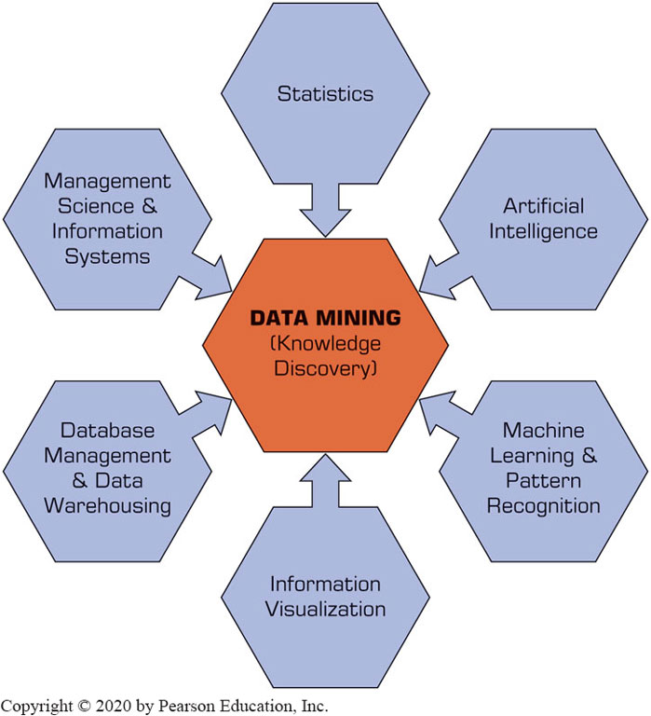
Data Mining Is a Blend of Multiple Disciplines

Slide 5
Data Mining Characteristics & Objectives
Source of data for DM is often a consolidated data warehouse (not always!).
DM environment is usually a client-server or a Web-based information systems architecture.
Data is the most critical ingredient for DM which may include soft/unstructured data.
The miner is often an end user
Striking it rich requires creative thinking
Data mining tools’ capabilities and ease of use are essential (Web, parallel processing, etc.)

Slide 6
How Data Mining Works
Extract patterns from data
Pattern? A mathematical (numeric and/or symbolic) relationship among data items
Types of patterns
Association
Prediction
Cluster (segmentation)
Sequential (or time series) relationships

Slide 7
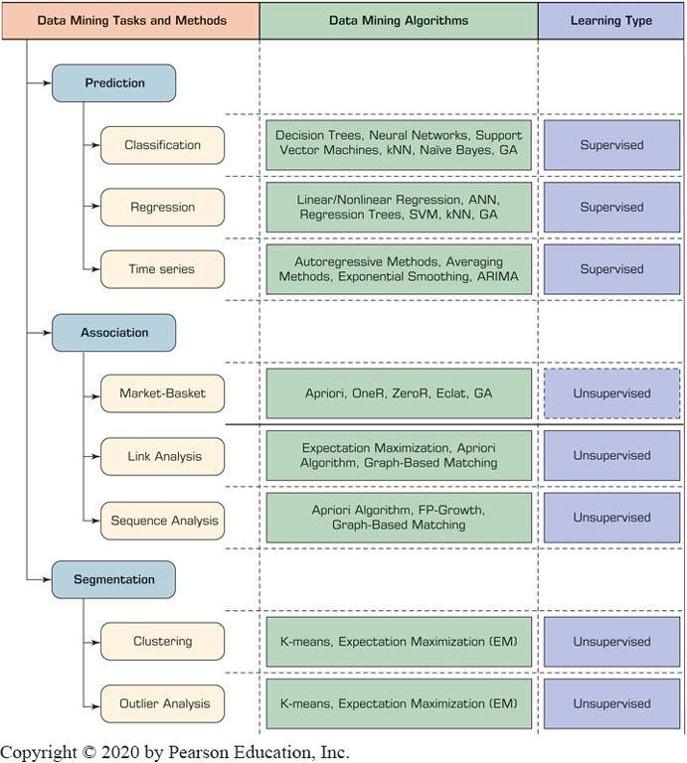
Taxonomy for Data Mining
A Simple Taxonomy for Data Mining Tasks, Methods, and Algorithms.

Slide 8
Data Mining Process
A manifestation of the best practices
A systematic way to conduct DM projects
Moving from Art to Science for DM project
Most common standard processes:
C R I S P-D M (Cross-Industry Standard Process for Data Mining)
S E M M A (Sample, Explore, Modify, Model, and Assess)
K D D (Knowledge Discovery in Databases)

Slide 9
Data Mining Process: C R I S P-D M
Cross Industry Standard Process for Data Mining
Proposed in 1990s by a European consortium
Composed of six consecutive steps
Step 1: Business Understanding
Step 2: Data Understanding
Step 3: Data Preparation
Step 4: Model Building
Step 5: Testing and Evaluation
Step 6: Deployment
Accounts for 85% of total project time

Slide 10
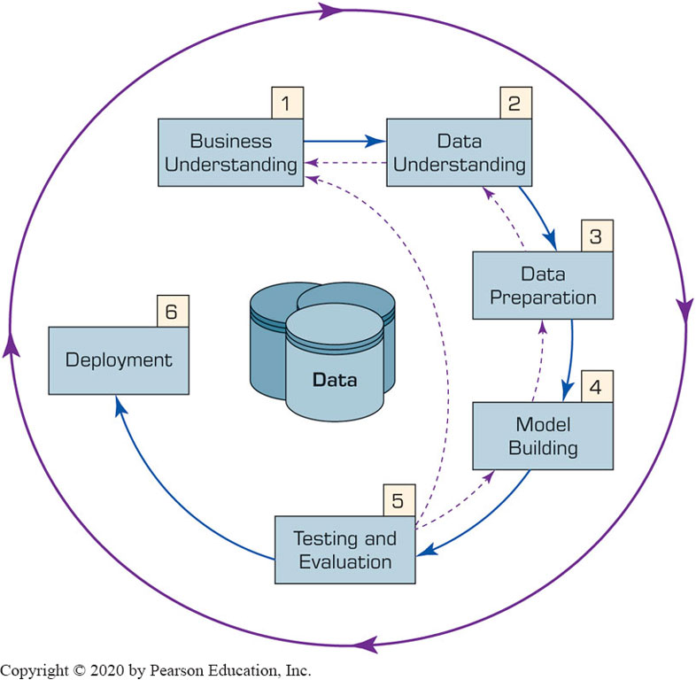
Data Mining Process: C R I S P-DM
The Six-Step CRISP-DM Data Mining Process
The process is highly repetitive and experimental (DM: art versus science?)

Slide 11
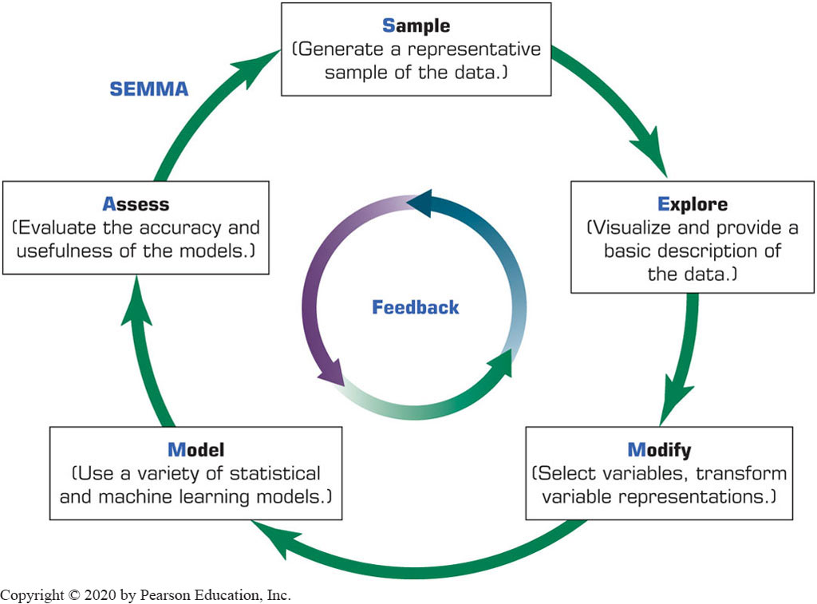
Data Mining Process: S E M M A
Developed by S A S Institute

Slide 12
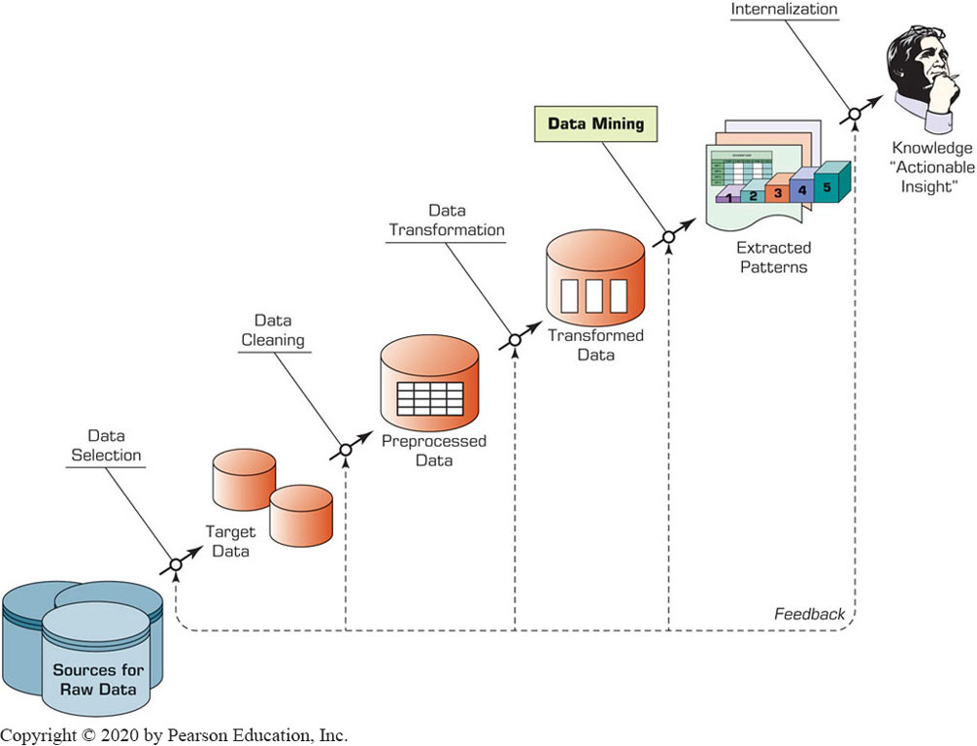
Data Mining Process: K D D

Slide 13
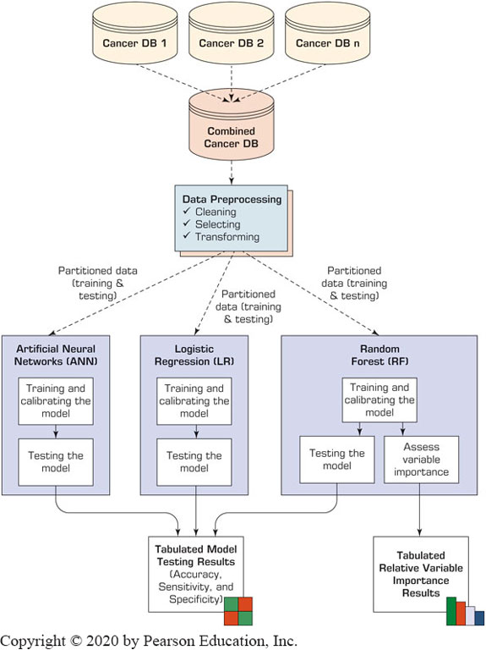
Data Mining – Cancer Research
Data mining example
Pay attention to the architecture
Note separation of tasks – data engineering and model development

Slide 14
Data Mining Methods: Classification
Most frequently used DM method
Part of the machine-learning family
Employ supervised learning
Learn from past data, classify new data
The output variable is categorical (nominal or ordinal) in nature
Consider:
Classification versus regression?
Classification versus clustering?

Slide 15
Assessment Methods for Classification
Predictive accuracy
Hit rate
Speed
Model building versus predicting/usage speed
Robustness
Scalability
Interpretability
Transparency
Explainability

Slide 16
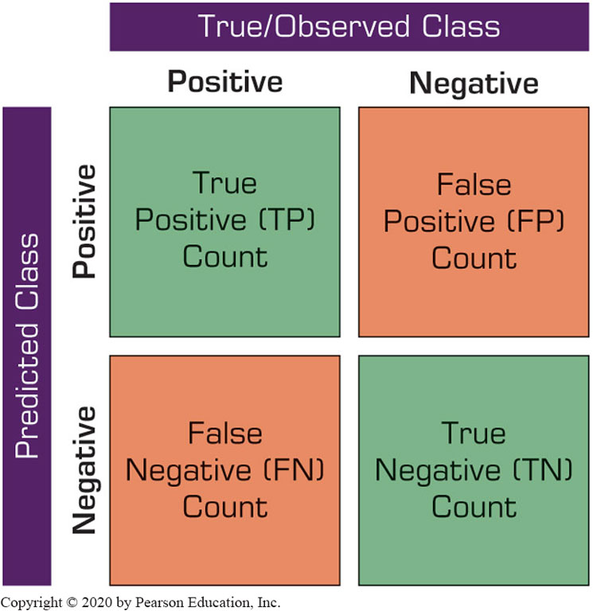
Accuracy of Classification Models
In classification problems, the primary source for accuracy estimation is the confusion matrix

Slide 17
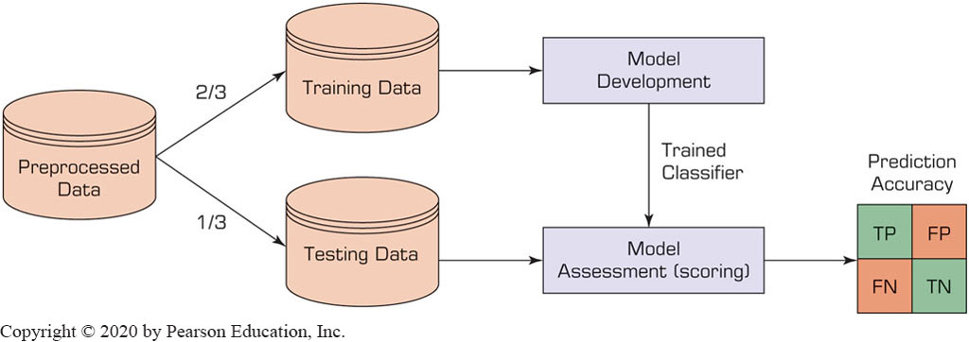
Estimation Methodologies for Classification: Single/Simple Split
Simple split (or holdout or test sample estimation)
Split the data into 2 mutually exclusive sets: training (~70%) and testing (30%)
For Neural Networks, the data is split into three sub-sets
training [~60%]
validation [~20%]
testing [~20%])

Slide 18
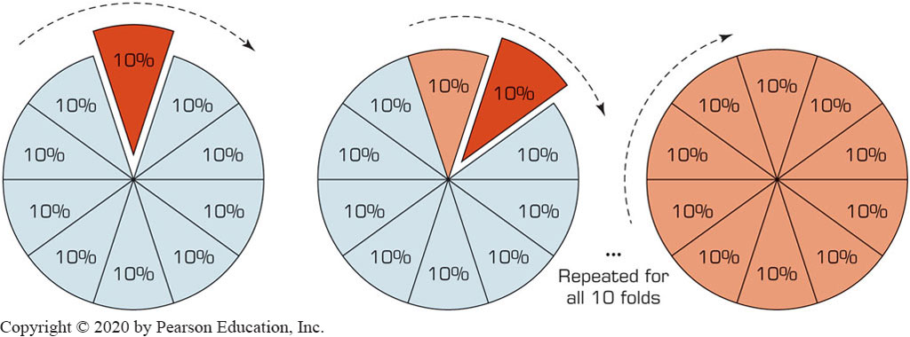
Estimation Methodologies for Classification: k-Fold Cross Validation
Data is split into k mutual subsets and k number training/testing experiments are conducted

Slide 19
Additional Estimation Methodologies for Classification
Leave-one-out
Similar to k-fold where k = number of samples
Bootstrapping
Random sampling with replacement
Jackknifing
Similar to leave-one-out
Area Under the ROC Curve (AUC)
ROC: receiver operating characteristics (a term borrowed from radar image processing)

Slide 20
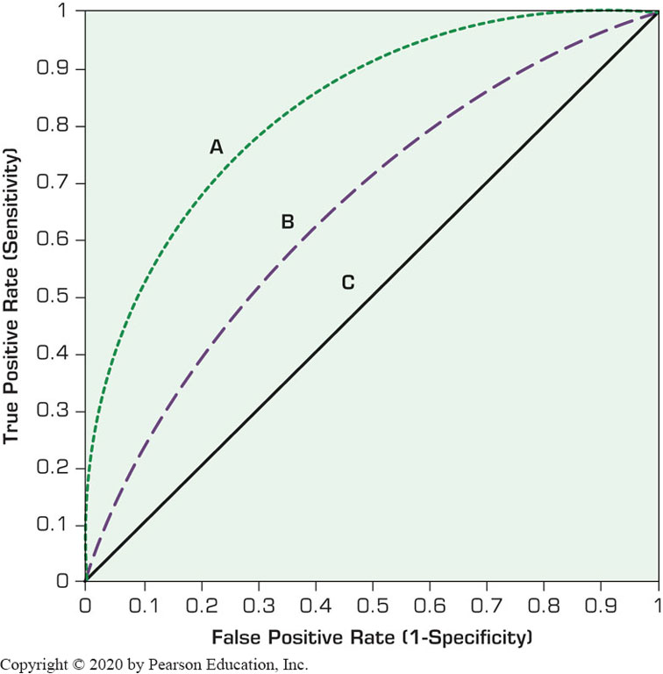
Area Under the R O C Curve (A U C)
Works with binary classification
Produces values from 0 to 1.0
Random chance is 0.5 and perfect classification is 1.0
Produces a good assessment for skewed class distributions too

Slide 21
Classification Techniques
Decision tree analysis
Statistical analysis
Neural networks
Support vector machines
Case-based reasoning
Bayesian classifiers
Genetic algorithms
Rough sets

Slide 22
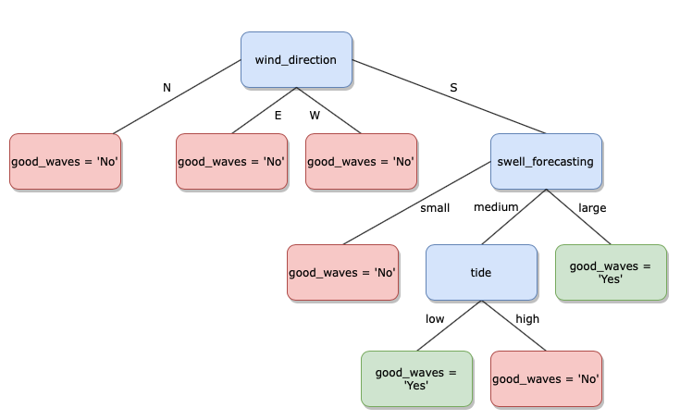
Decision Trees
Employs a divide-and-conquer method
Recursively divides a training set until each division consists of examples from one class:
Create a root node and assign all of the training data to it.
Select the best splitting attribute.
Add a branch to the root node for each value of the split. Split the data into mutually exclusive subsets along the lines of the specific split.
Repeat steps 2 and 3 for each and every leaf node until the stopping criteria is reached.

Slide 23
Decision Trees – Algorithms
Decision tree algorithms differ on:
Splitting criteria – which variable, what value, etc.
Stopping criteria – when to stop building the tree
Pruning (generalization method) – pre-pruning versus post-pruning
Most popular decision tree algorithms include:
ID3
C4.5
C5
CART
CHAID
M5

Slide 24
Cluster Analysis for Data Mining
Used for automatic identification of natural groupings of things
Part of the machine-learning family
Employs unsupervised learning
Learns the clusters of things from past data, then assigns new instances
There is not an output/target variable
In marketing, it is also known as segmentation

Slide 25
Cluster Analysis for Data Mining
Clustering results may be used to
Identify natural groupings of customers
Identify rules for assigning new cases to classes for targeting/diagnostic purposes
Provide characterization, definition, labeling of populations
Decrease the size and complexity of problems for other data mining methods
Identify outliers in a specific domain (e.g., rare-event detection)

Slide 26
Cluster Analysis for Data Mining
Analysis methods
Statistical methods (including both hierarchical and nonhierarchical), such as k-means, k-modes, and so on.
Neural networks – adaptive resonance theory (ART), self-organizing map (SOM)
Fuzzy logic (e.g., fuzzy c-means algorithm)
Genetic algorithms

Slide 27
Cluster Analysis for Data Mining
k-Means Clustering Algorithm
k: pre-determined number of clusters
Algorithm
Step 0: determine value of k
Step 1: Randomly generate k random points as initial cluster centers.
Step 2: Assign each point to the nearest cluster center.
Step 3: Re-compute the new cluster centers.
Repetition step: Repeat steps 3 and 4 until some convergence criterion is met (usually that the assignment of points to clusters becomes stable).

Slide 28
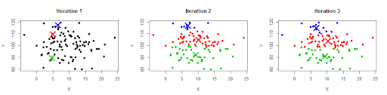
Cluster Analysis for Data Mining - k-Means Clustering

Slide 29
Association Rule Mining
A very popular data mining method in business
Finds interesting relationships (affinities) between variables (items or events)
Part of machine learning family
Employs unsupervised learning
There is no output variable
Also known as market basket analysis
Often used as an example to describe data mining to ordinary people, such as the famous “relationship between diapers and beers!”

Slide 30
Association Rule Mining
Input: simple point-of-sale transaction data
Output: Most frequent affinities among items
Example: according to the transaction data…
“Customers who bought a laptop computer and a virus protection software, also bought extended service plan 70% of the time."
How do you use such a pattern/knowledge?
Put the items next to each other
Promote the items as a package
Place items far apart from each other!

Slide 31
Association Rule Mining
Representative applications of association rule mining includes:
In Business
In Medicine
cross-marketing
cross-selling
store design
catalog design
e-commerce site design
optimization of online advertising
product pricing
sales/promotion configuration
relationships between symptoms and illnesses
diagnosis and patient characteristics and treatments
genes and their functions (genomics projects)

Slide 32
Association Rule Mining
Several algorithms are developed for discovering (identifying) association rules
Apriori
Eclat
F P-Growth
+ Derivatives and hybrids of the three
The algorithms help identify the frequent item sets, which are, then converted to association rules

Slide 33
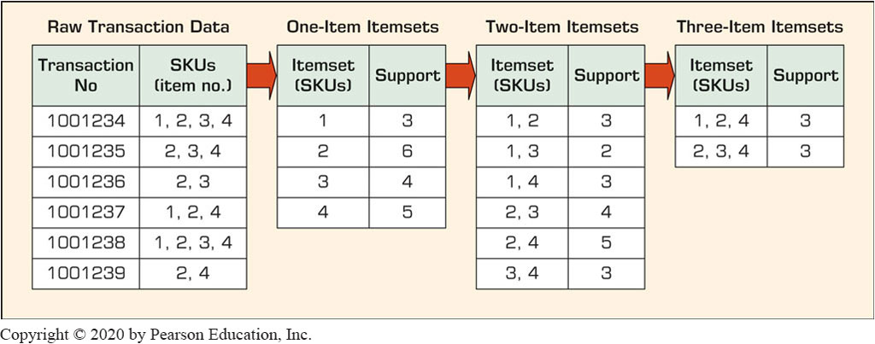
Association Rule Mining – Apriori Algorithm
Finds subsets that are common to at least a minimum number of the itemsets
Uses a bottom-up approach
frequent subsets are extended one item at a time (the size of frequent subsets increases from one-item subsets to two-item subsets, then three-item subsets, and so on), and
groups of candidates at each level are tested against the data for minimum support.

Slide 34
Popular Data Mining Software Tools
Commercial
I B M S P S S Modeler
S A S Enterprise Miner
Statistica - Dell/Statsoft
Free and/or Open Source
K N I M E
RapidMiner
Weka
R

Slide 35
Data Mining Myths
Myth
Reality
Data mining provides instant, crystal-ball-like predictions.
Data mining is not yet viable for mainstream business applications.
Data mining requires a separate, dedicated database.
Only those with advanced degrees can do data mining.
Data mining is only for large firms that have lots of customer data.
Data mining is a multistep process that requires deliberate, proactive design and use.
The current state of the art is ready for almost any business type and/or size.
Advances in database technology means a dedicated database is not required.
Newer Web-based tools enable managers of all educational levels to do data mining.
If the data accurately reflect the business or its customers, any company can use data mining.

Slide 36
Data Mining Mistakes
Selecting the wrong problem for data mining
Ignoring what your sponsor thinks data mining is and what it really can/cannot do
Beginning without the end in mind.
Not leaving sufficient time for data acquisition, selection and preparation
Looking only at aggregated results and not at individual records/predictions

